Slide 1
Salesforce Partnership
Dreamforce debrief
Financial Services Cloud, Marketing Cloud, Agentforce
West Monroe, Deloitte, Accenture
Industry trends
POV / Proposal from West Monroe
Approaching Salesforce
Cognitive Banking
Who we are and the banks we serve
How we help Salesforce differentiate with a new competitive advantage
Notes:
Challenge 1: Traditional PFM is not making impact. The ROI is not there. Because of e.g. Low adoption, And barely influencing customer behavior. E.g. are financially vulnerable customers actually building a savings habit?
Challenge 2: Selling through p0the mobile app. At most segmented campaigns that have low CTRs.
Solution:
Our Cognitive Banking Platform uniquely combines financial wellness with need-based selling. By delivering real-time, AI-driven insights, we empower individuals to take control of their financial lives — driving higher engagement, trust, and meaningful customer actions. For Rabobank, this means the opportunity to deepen customer relationships, build loyalty, and lead the way in the AI-driven banking era. Personetics provides your customers an AI-Powered Customer Experience that Drives Results.

Slide 2
Salesforce Opportunity Metrics based on sample of 55 Existing Personetics Customers
51%
35%
18%
5%
of existing customers have purchased CRM or FSC in the Retail or SMB Business Unit
of existing customers have purchased Marketing Cloud in the Retail or SMB Business Unit
of existing customers have purchased Data Cloud
of existing customers have purchased Agentforce
Notes:
Challenge 1: Traditional PFM is not making impact. The ROI is not there. Because of e.g. Low adoption, And barely influencing customer behavior. E.g. are financially vulnerable customers actually building a savings habit?
Challenge 2: Selling through p0the mobile app. At most segmented campaigns that have low CTRs.
Solution:
Our Cognitive Banking Platform uniquely combines financial wellness with need-based selling. By delivering real-time, AI-driven insights, we empower individuals to take control of their financial lives — driving higher engagement, trust, and meaningful customer actions. For Rabobank, this means the opportunity to deepen customer relationships, build loyalty, and lead the way in the AI-driven banking era. Personetics provides your customers an AI-Powered Customer Experience that Drives Results.

Slide 3
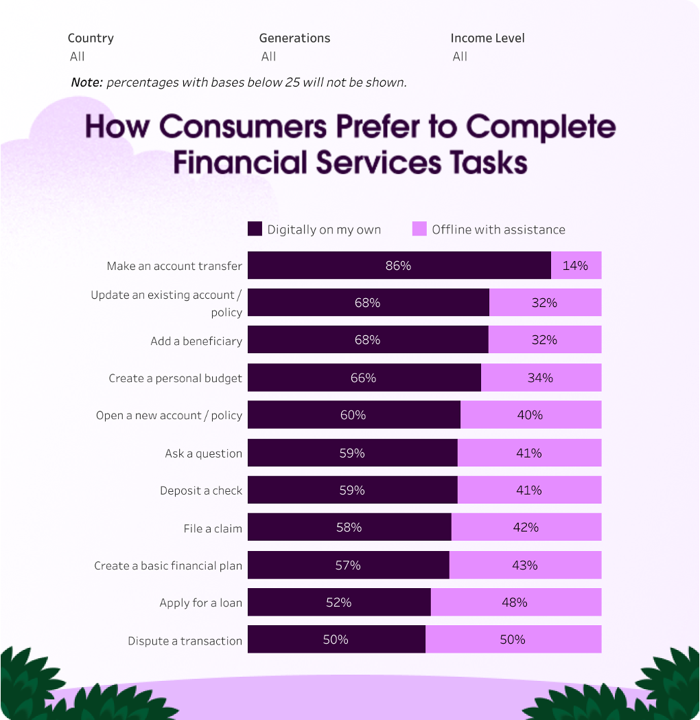
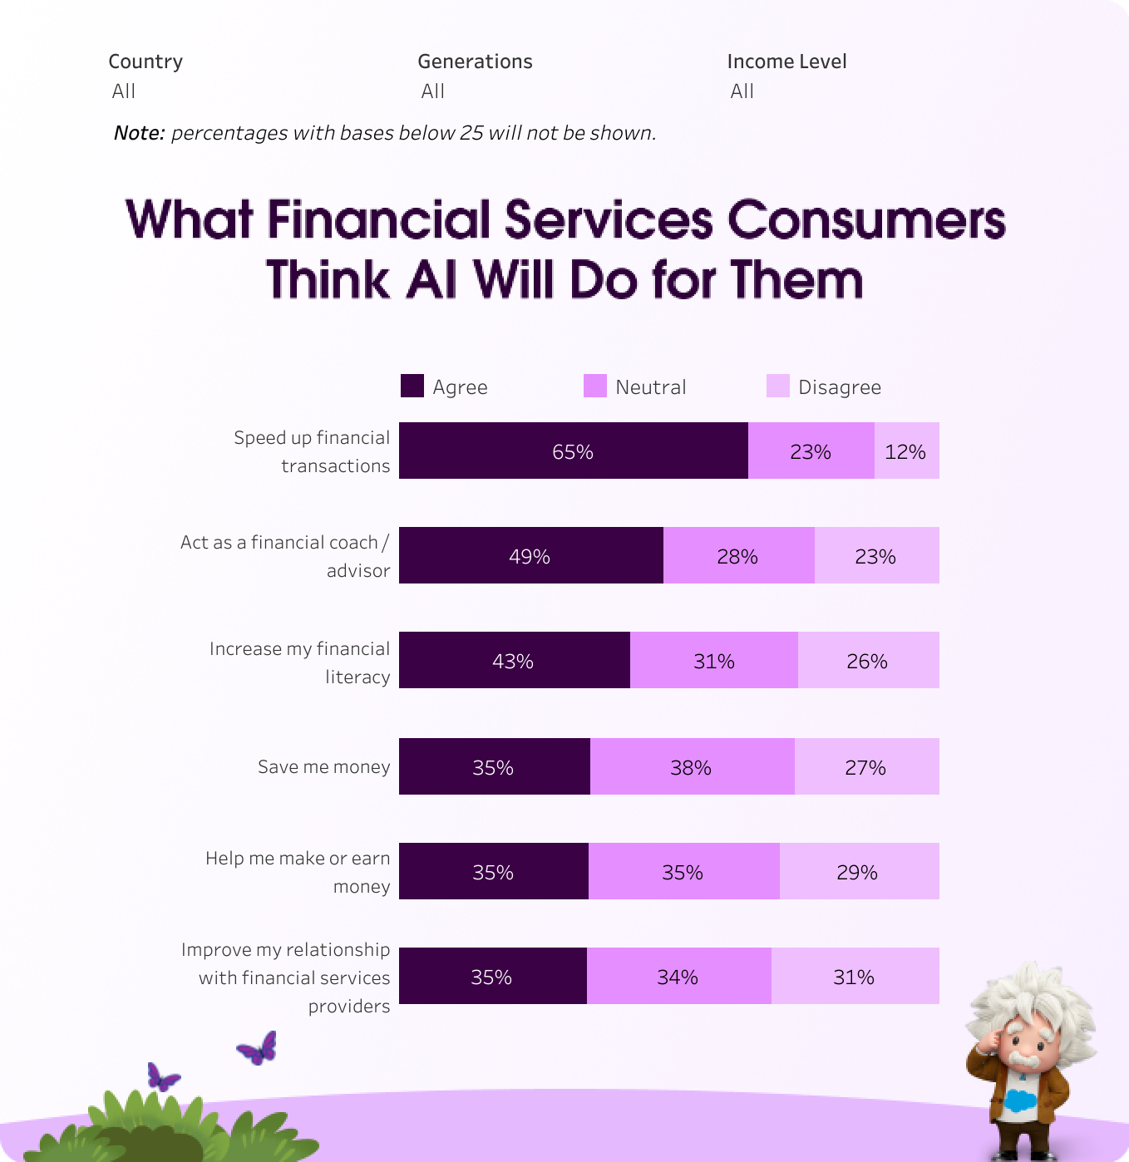
Consumers preference shift to AI for Financial Services
Only 41% of wealth management clients are fully satisfied with their institutions’ customer service speed and effectiveness
65% of consumers now expect AI to speed up financial transactions, up from 46% in 2023
Source: https://www.salesforce.com/news/stories/financial-services-statistics-2025/
Notes:
https://public.tableau.com/app/profile/salesforce.newsroom1206/viz/HowConsumersPrefertoCompleteFinancialServicesTasks/Embed1

Slide 4
Trends – Salesforce.com Dreamforce
Agentic Enterprise: AI as add on to AI agents embedded in business processes (Scale and Embed)
Enterprise-scale deployment: going from pilot projects to production
Foundational pillars: data, governance, and trust
Data layer evolution: Data 360 the Data that drives the agents
Enhanced data layer to support agents with rich, trusted real-time context
“Zero-copy” connectors to existing data stores
Unified AI platform: Agentforce 360: Unifying Salesforce’s apps under a single “agentic” layer
Agent builder / voice interaction / conversational interface
Low code for broader Adoption
Pilot → Production → Scale mindset: Deploying AI with measurable mindset
Show ROI, governance, standards, and cross-functional alignment
Source: https://www.salesforce.com/news/stories/financial-services-statistics-2025/

Slide 5
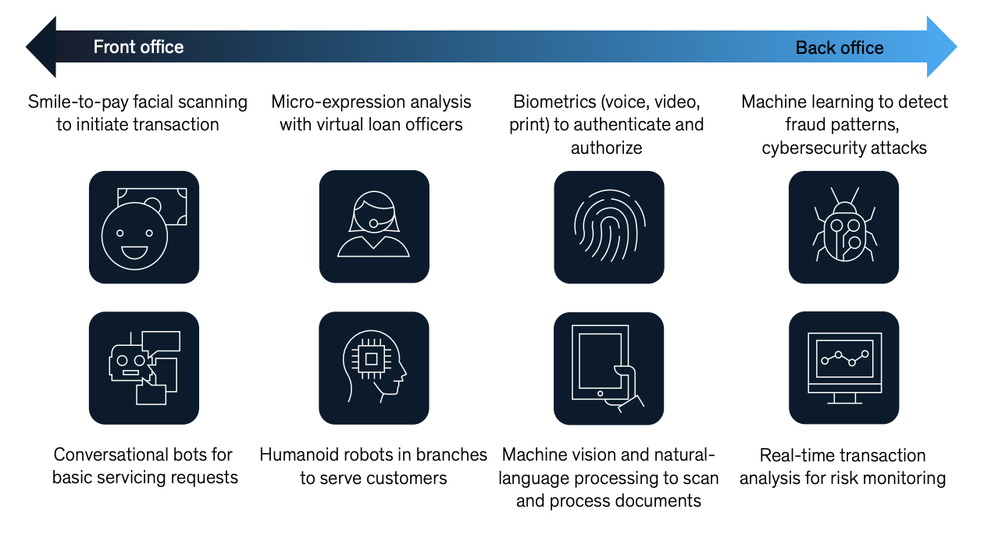
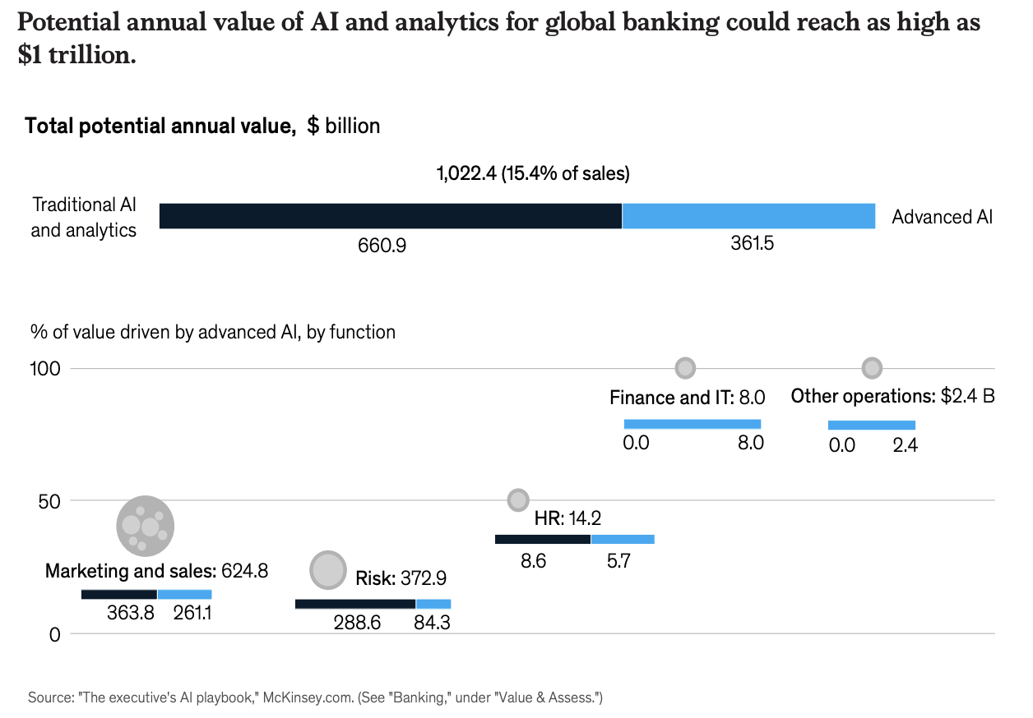
Banks recognizing AI's massive value potential
FIs leveraging AI across the banks infrastructure

Slide 6
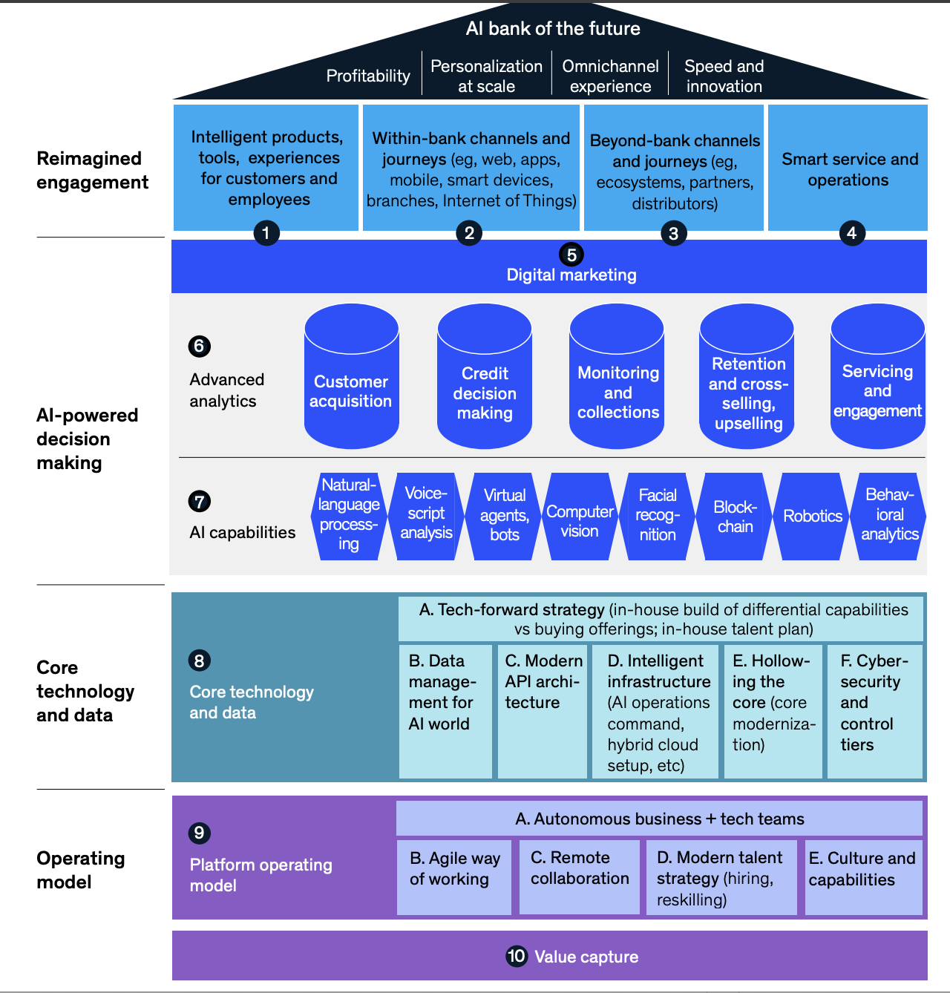
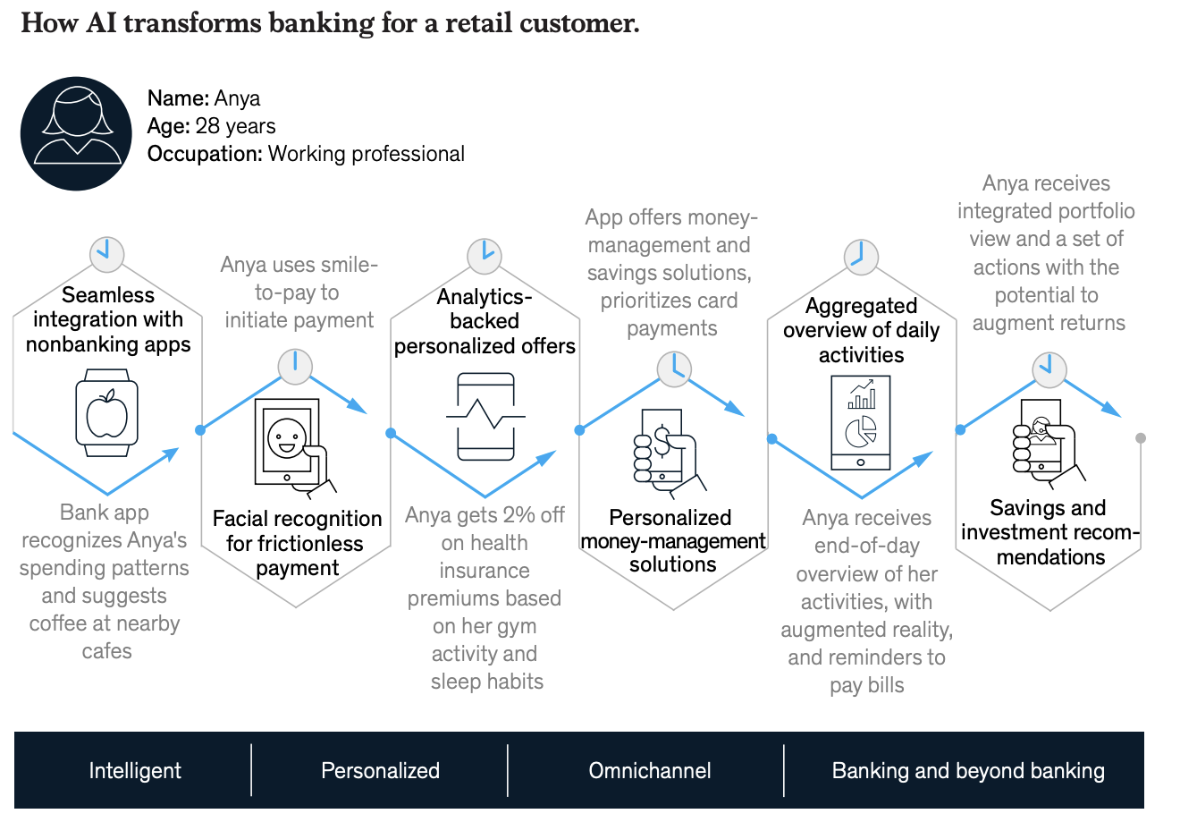
SF AI penetration across the banks' fabric: across channels and departments
Source: McKnseyAI-bank of the future: Can banks meet the AI challenge?
PenFed Credit Union is deploying Einstein AI as a virtual assistant to suggest chat and email responses, helping service representatives answer questions faster and reduce queues. The company achieved a 40% reduction in support headcount through AI implementation
Santander's Corporate and Commercial Banking team leverages AI to scale their Navigator platform, using CRM Analytics to visualize international trade trends and generate personalized recommendations.

Slide 7
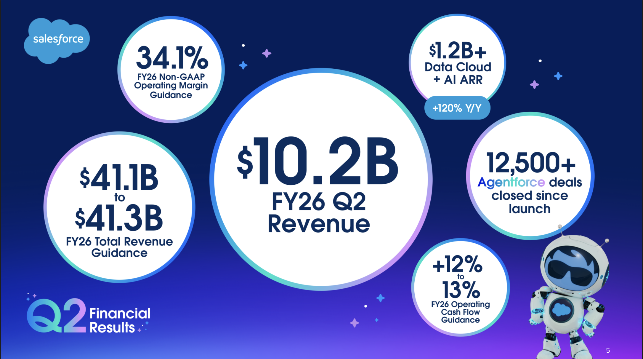
Salesforce - explosive growth in financial services AI adoption
Salesforce.com main AI initiatives for Financial Services Cloud:
Safeguard data, privacy, security, and trust
Discover sales opportunities faster with AI
Leverage AI in banking to scale next-level marketing personalization
Improve service representative training and customer satisfaction with AI
“Agentic AI solutions like Agentforce will scale a limitless expert digital labor force for financial institutions,” Eran Agrios, SVP & GM of Financial Services at Salesforce

Slide 8
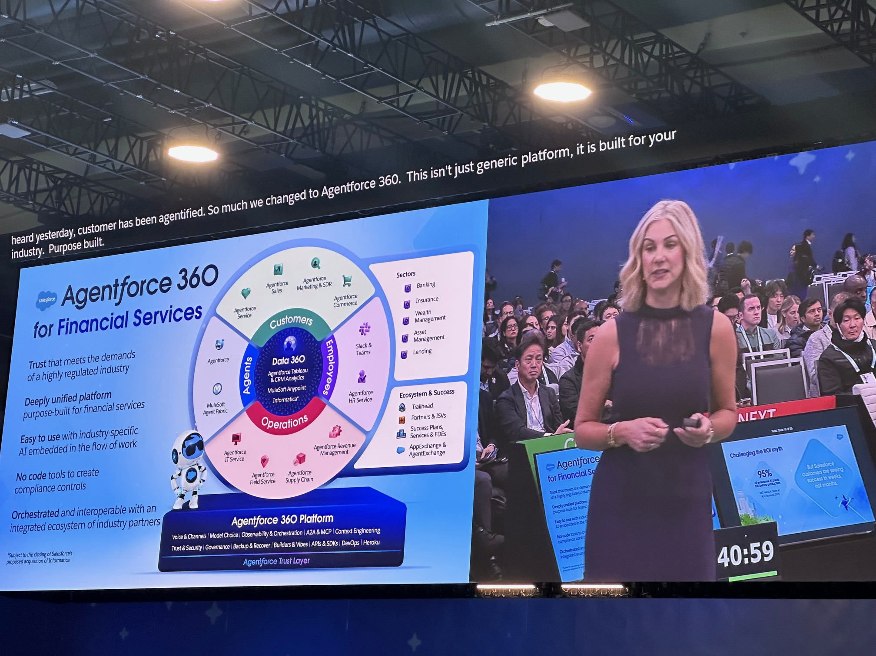
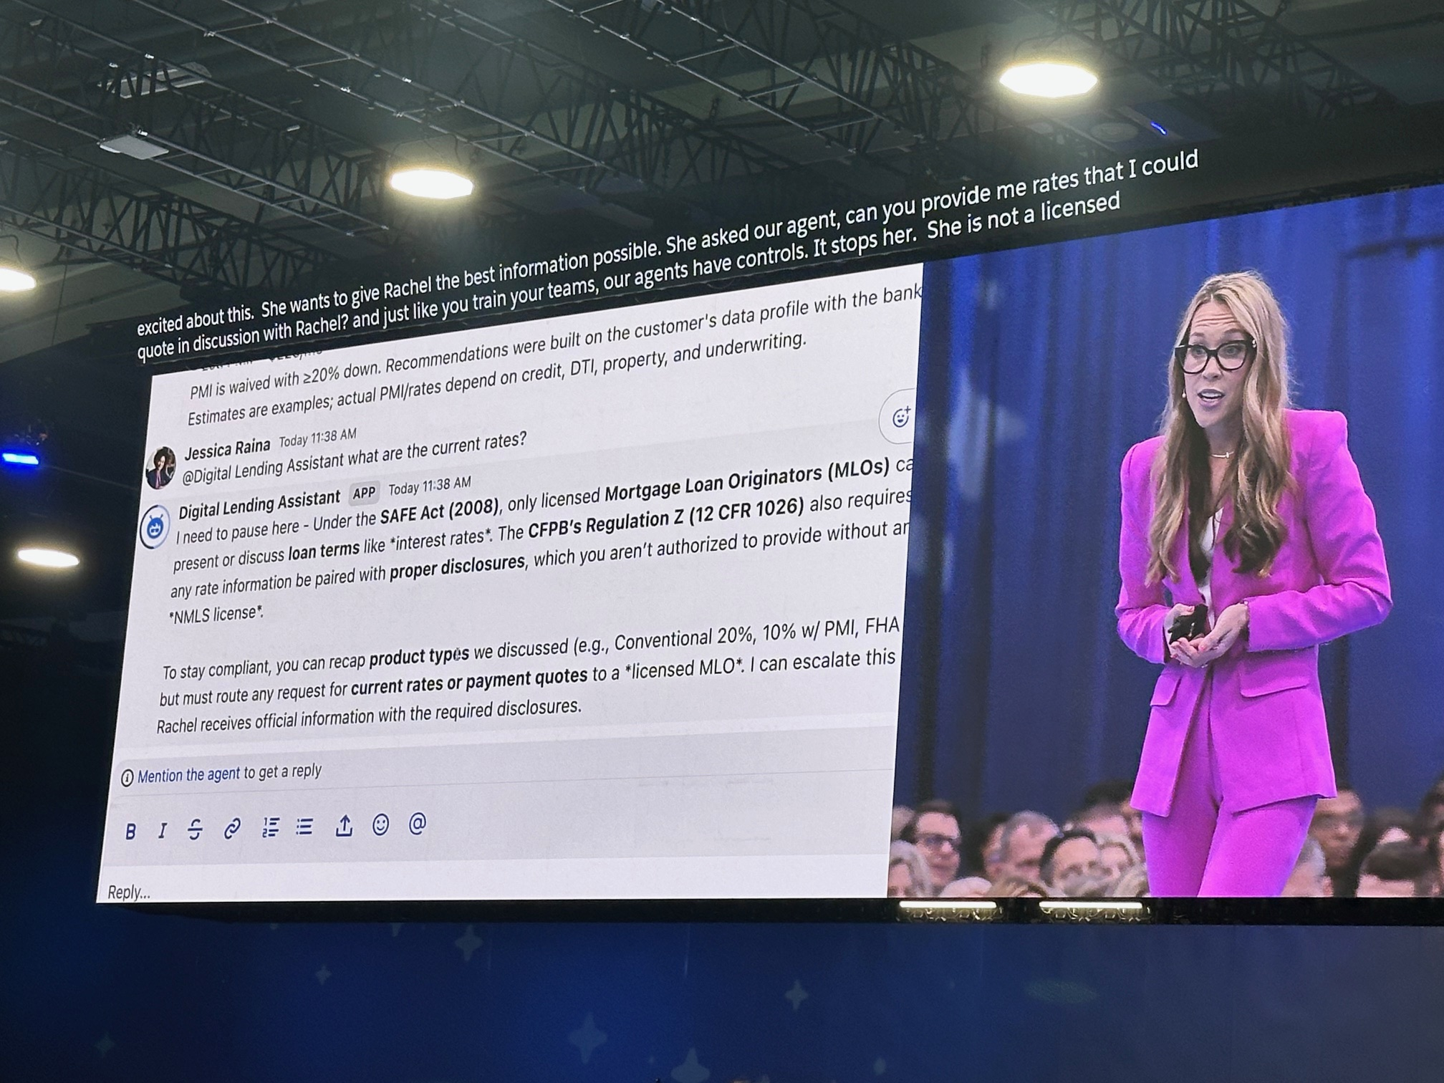
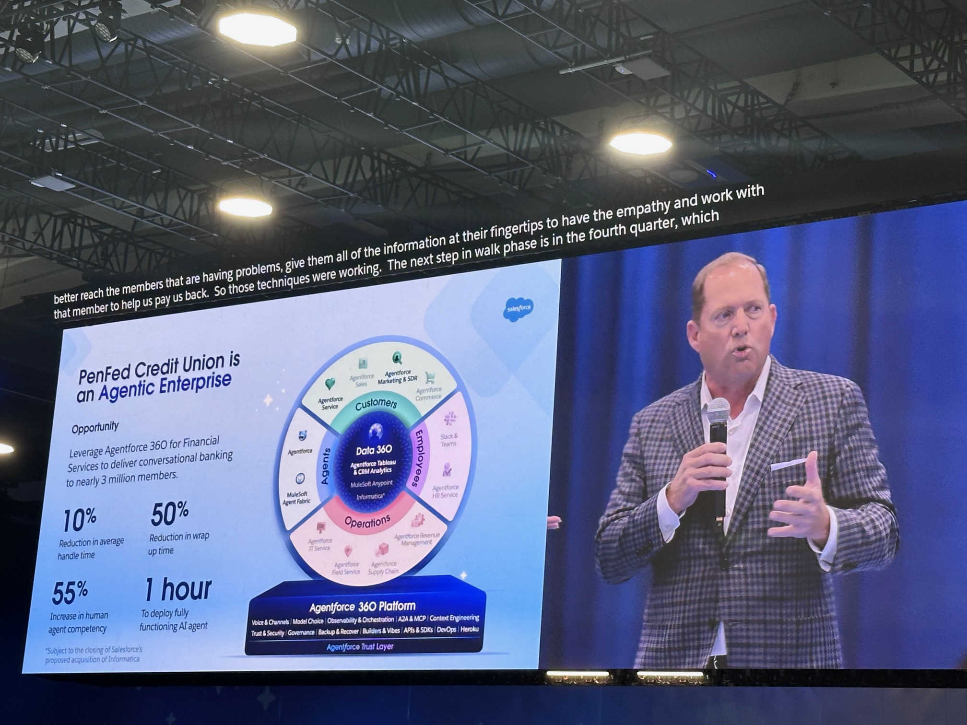
Dreamforce 2025 – Agentforce 360 and Data 360 as main focus

Slide 9
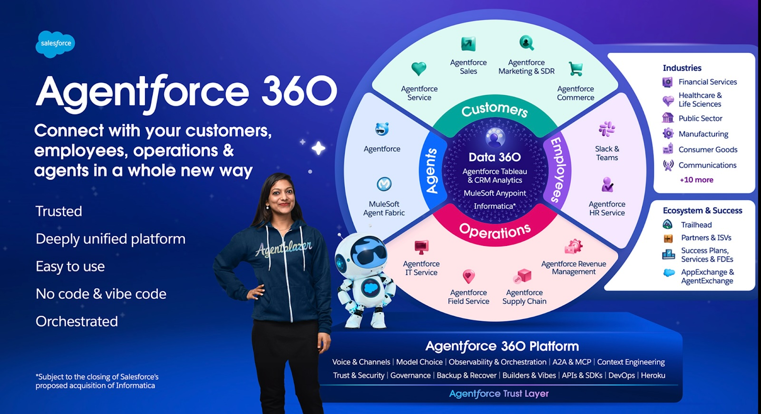
Agentforce 360

Slide 10
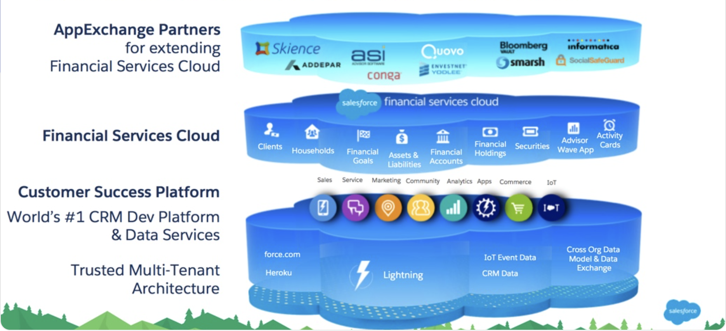
Financial Services Cloud

Slide 11
Personetics x Salesforce Partnership – Elevating Cognitive Banking in the Salesforce Ecosystem
Transforming Cognitive Banking for the Agentic Enterprise

Slide 12
Today’s Objectives
1
Cognitive Banking
2
Strategic Alignment
3
Enterprise (Multi-cloud) Asset
4
Cognitive Banking

Slide 13










A New Breed of Customers with Different Expectations
Fully understanding each customer on a personal level
Uniquely tailoring every interaction
Predicting & anticipating customer needs
Fulfilling the needs with a click of a button
Learning and optimizing from each customer touchpoint

Slide 14
Customers have more control and higher expectations ... raising the stakes for banking to improve.
v

Slide 15



When Banks Fail to Meet Expectations, Customers Look Elsewhere
60%
increase in account switching between 2018-2024
59%
acquired a financial services product from a new provider in the past 12 months
82%
Gen Z acquired a financial services product from a new provider in the past 12 months
13%
retail bank customers say they are likely to switch banks in the next 12 months
of consumers would consider changing banks to get personal services
84%
15
Notes:
https://www.accenture.com/il-en/insights/banking/consumer-study-banking-reignite-human-connections
https://www.accenture.com/content/dam/accenture/final/industry/banking/document/Accenture-Banking-Consumer-Study.pdf
https://www.jdpower.com/sites/default/files/file/2024-03/2024028%20U.S.%20Retail%20Banking%20Satisfaction.pdf
13% of retail bank customers say they “probably will” or “definitely will” switch banks in the next 12 months. – J.D. Powers ( March 2024)

Slide 16
Financial Wellness
Needs-Based Sales

Slide 17
Cognitive Banking
Financial Wellness
Needs-Based Sales

Slide 18

Cognitive Banking: Helping Bridge the Human-like Experience Divide
Cognitive Banking
Customer Engagement
Needs Based Advice / Offer
AI-Powered Customer Engagement​ that Drives Results​
Notes:
Challenge 1: Traditional PFM is not making impact. The ROI is not there. Because of e.g. Low adoption, And barely influencing customer behavior. E.g. are financially vulnerable customers actually building a savings habit?
Challenge 2: Selling through p0the mobile app. At most segmented campaigns that have low CTRs.
Solution:
Our Cognitive Banking Platform uniquely combines financial wellness with need-based selling. By delivering real-time, AI-driven insights, we empower individuals to take control of their financial lives — driving higher engagement, trust, and meaningful customer actions. For Rabobank, this means the opportunity to deepen customer relationships, build loyalty, and lead the way in the AI-driven banking era. Personetics provides your customers an AI-Powered Customer Experience that Drives Results.

Slide 19
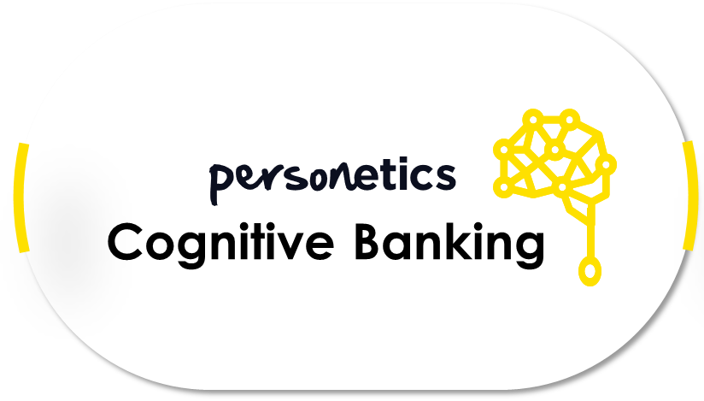


Learn & Improve
Analyze Customer Transactions
Present Financial Profile
Understand Current Needs
Predict Future Needs
Enable Needs-Based Actions
In-depth analysis of customer transactions and additional data sources using tailored models to build a personal financial profile
Present a clear, practical and digestible overview of the customer’s financial profile
Identify and assess immediate financial needs, and offer actionable insights to improve financial health
Predict & anticipate upcoming financial challenges and opportunities to allow to stay ahead of the curve
In context, allow the customer to act upon their needs with a click of a button, or even automatically
19

Slide 20




































: The Global Leader in Cognitive Banking
100+
Banks on products worldwide
150M+
Active Monthly Users
50%
Of the largest retail banks in North America
30
Customer countries
4.6/5
Engagement score
AI-Powered Customer Engagement​ that Drives Results​

Slide 21






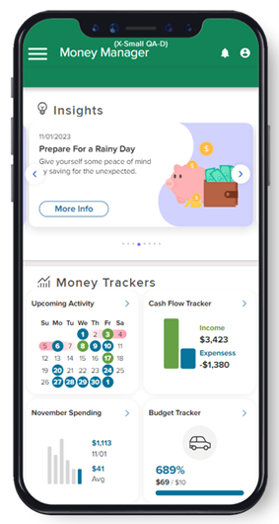

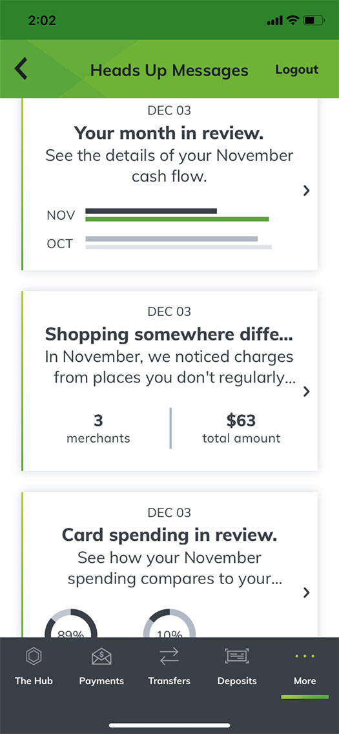
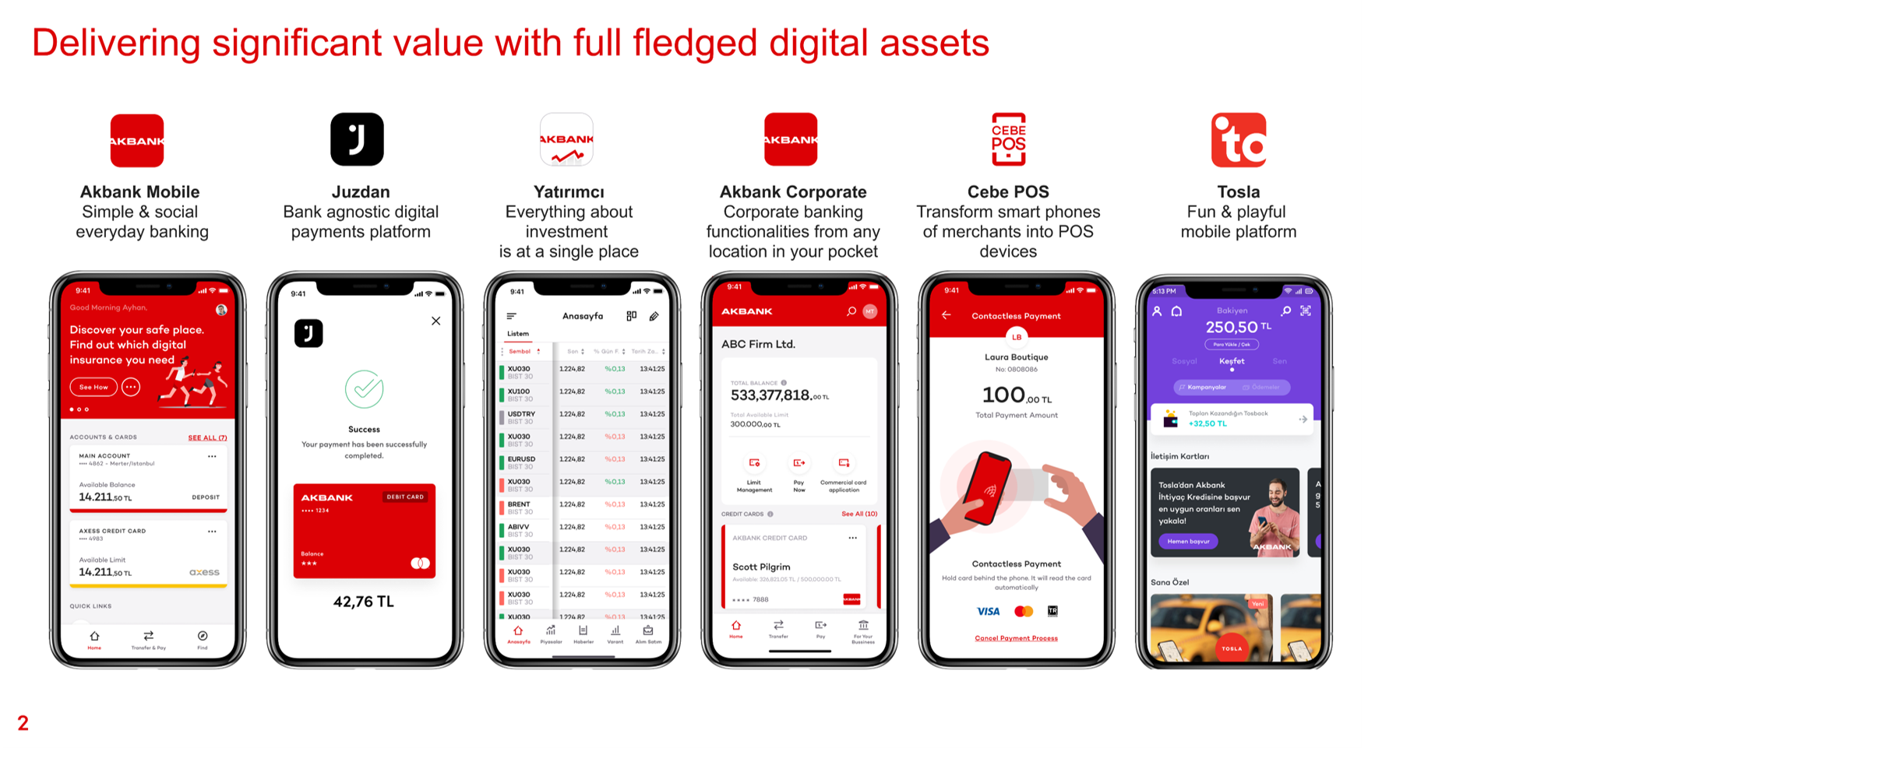
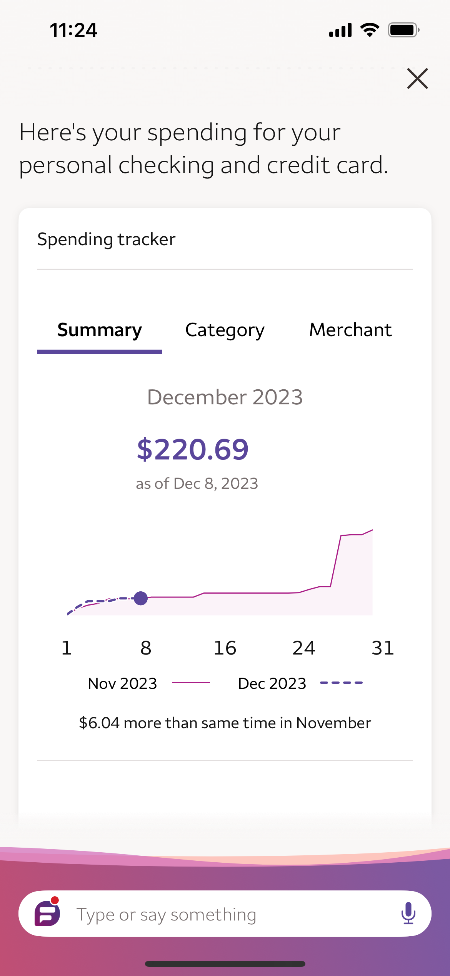
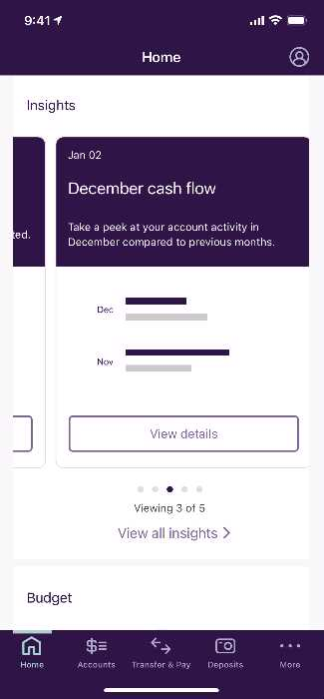
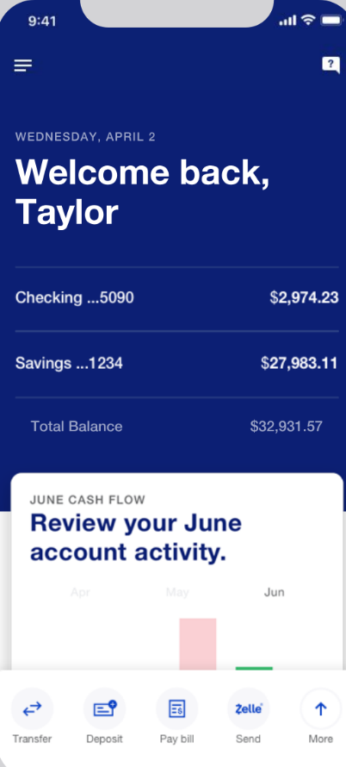
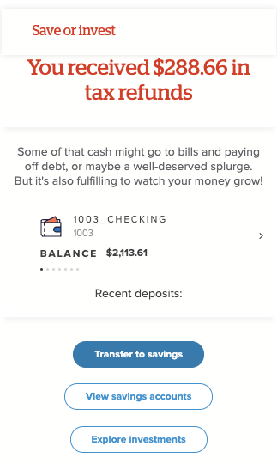
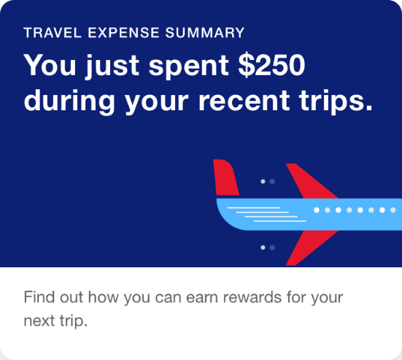
Driving Moment Oriented Experiences across 150MM+ Consumers & SMBs
Powered by transaction and engagement intelligence
Notes:
This isn't a theory. It's a proven strategic approach that's been adopted by many of the world's largest, most innovative banks

Slide 22
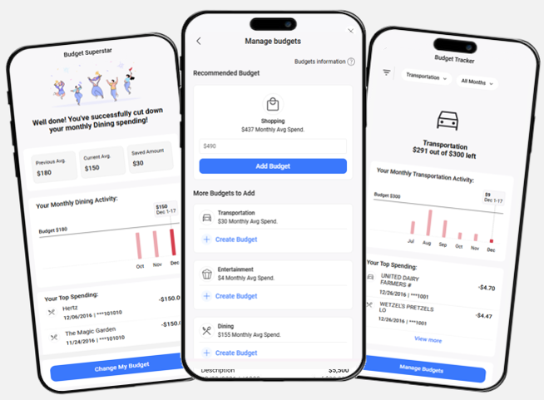


From CRM to Intelligent Engagement
Personetic's cognitive banking to power the transition from product led sales to relationship engagement at every customer touch point
Cognitive Banking AI-driven financial wellness within the Salesforce ecosystem
system of banker engagement
Transaction and engagement intelligence
Consumer Digital engagement
Notes:
We need to use their wording -

Slide 23

Bringing Cognitive Banking to the Agentic Enterprise
Personetic’s Cognitive Banking platform to power the agentic enterprise with rich context from transaction and customer engagement intelligence
Digital Banking (Web/Mobile)
Bank Operational Ecosystem
Customer Engagement Intelligence
Personetics Transaction Intelligence
Bank Transaction Data
Notes:
We need to use their wording -

Slide 24

Deliver Personalized Human Experiences, Powered by Context Rich Agents
Financial Services Agentforce (FSC)
Marketing Cloud
Service Cloud
Agentforce
Enable marketing teams to create segmented, hyper-personalize campaigns based on transaction and customer engagement intelligence across all channels. Track campaign performance and attrition through the bank’s digital channel.
Enable bankers to proactively recommend contextual financial solutions based on predictive intelligence. Bankers and customers collaborate on setting goals and budgets, bridging intelligence into a deep, personalized human experience.
Embed real-time AI-driven financial insights that instantly flag suspicious transactions for proactive fraud intervention. This rich context also enables agents to deliver faster, highly personalized, proactive service and advisory support, moving beyond reactive problem-solving.
Transform the bank into an Agentic Enterprise, across multiple Salesforce solutions with predictive, contextual financial insights, the 'gold standard data needed to drive agentic AI into the fabric of the bank
Data 360
Personetics Transaction & Customer Engagement Intelligence
Notes:
We need to use their wording -

Slide 25
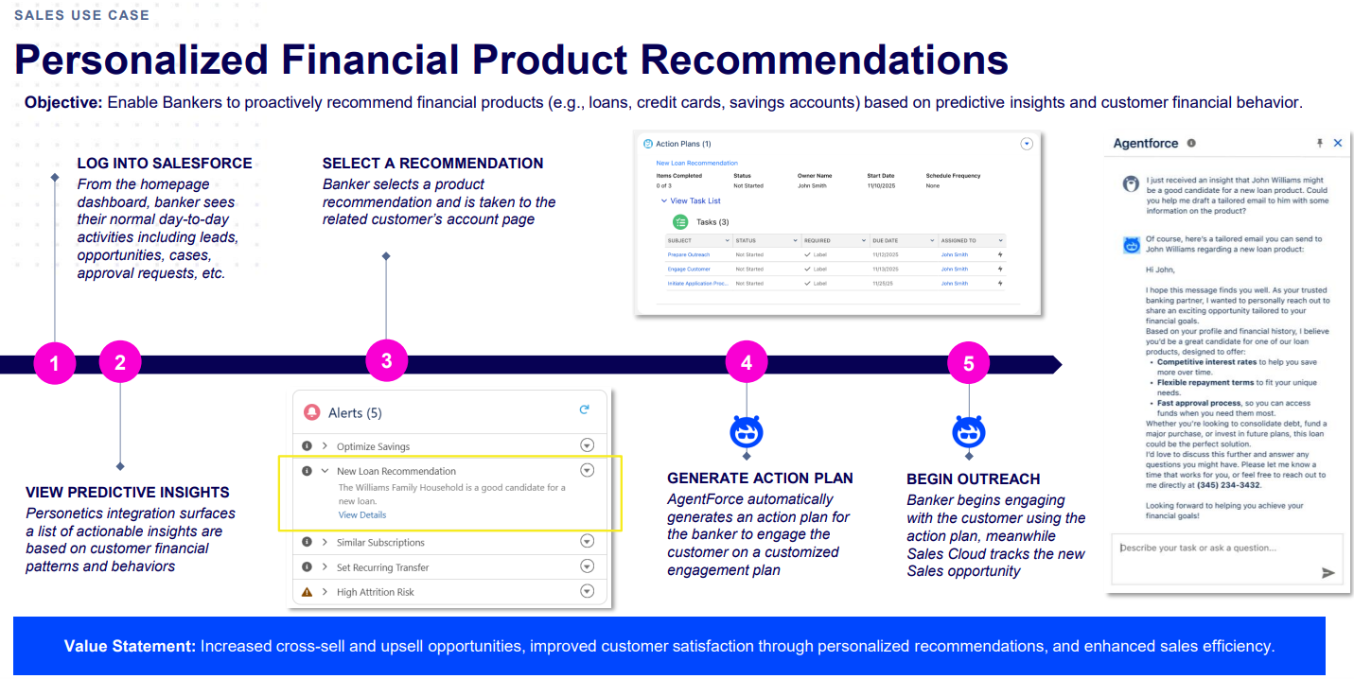
Agentforce Financial Services (FSC) – Use Case

Slide 26
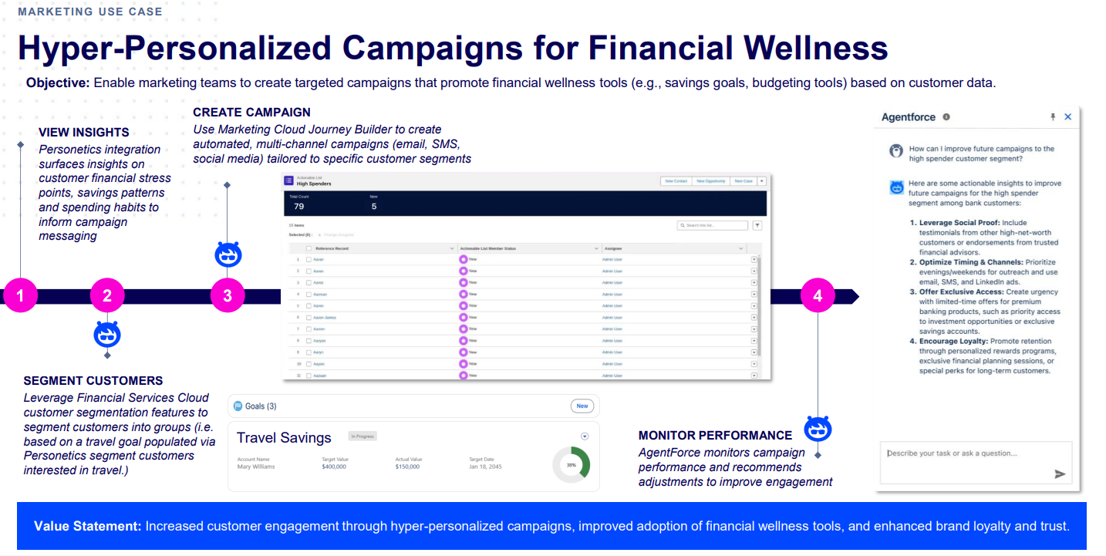
Marketing Cloud – Use Case

Slide 27



Salesforce x Personetics Partnerships
Integrate Personetics’ insights & customer actions with salesforce clouds for personalized customer engagement that boosts revenue, cut service costs, and maximizes banker productivity.
Actionable Data
Revenue impact
Platform adoption
Provide better visibility by augmenting salesforce data with Personetics insights and goals
Greater data visibility enhances customer experience and retention, while also driving stronger cross-platform marketing campaigns and improving overall data quality.
By increasing value for FIs, we drive greater adoption of both Salesforce and Personetics.

Slide 28
Personetics x Salesforce
Leverage Personetics financial insights over FSC and AgentForce 360 for:
Bankers Assist - Personalized Financial Product Recommendations (Financial Services Cloud)
Enable Bankers to proactively recommend financial products, based on predictive insights and customer financial behavior.
Cross channel Marketing - Hyper-personalized campaigns for financial wellness (Marketing Cloud )
Enable marketing teams to create targeted campaigns that promote financial wellness tools, based on customer data.
Real Time Customer Service & Fraud Prevention (Financial Services Cloud)
Seamlessly detect Fraud, through insights and seamless case management
Sales
Marketing
Service
Agentforce 360
Financial Services Cloud

Slide 29
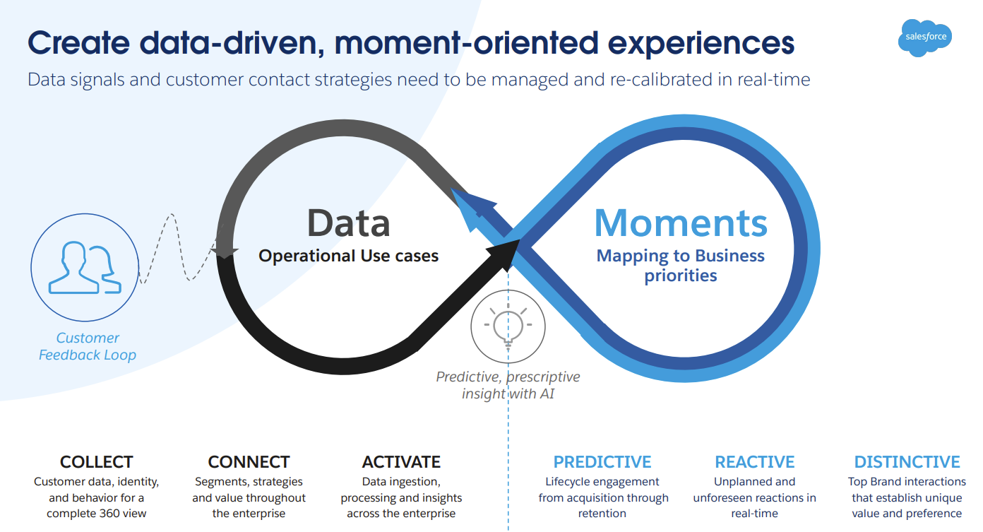
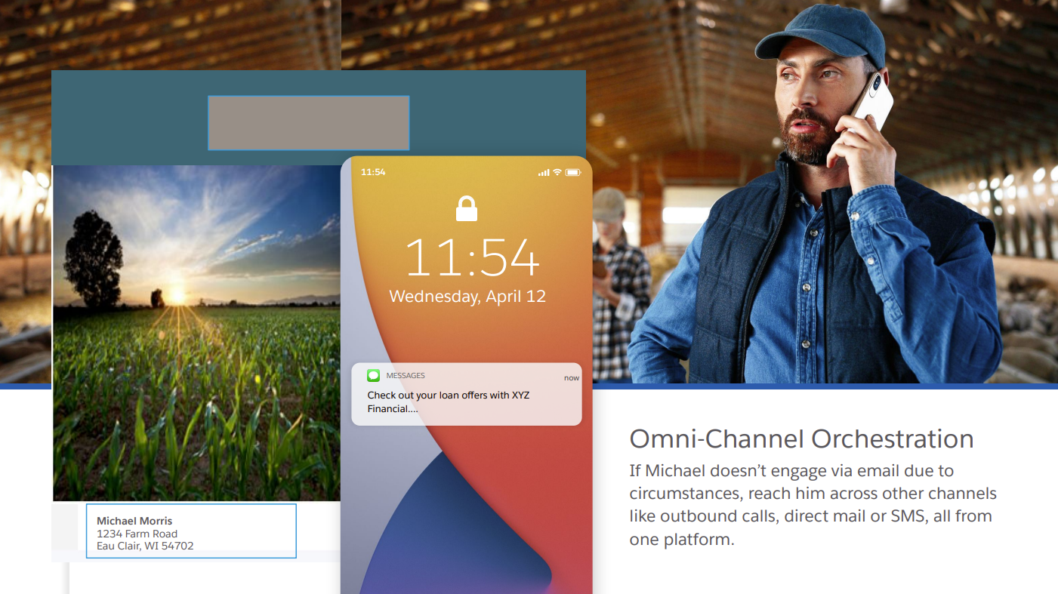
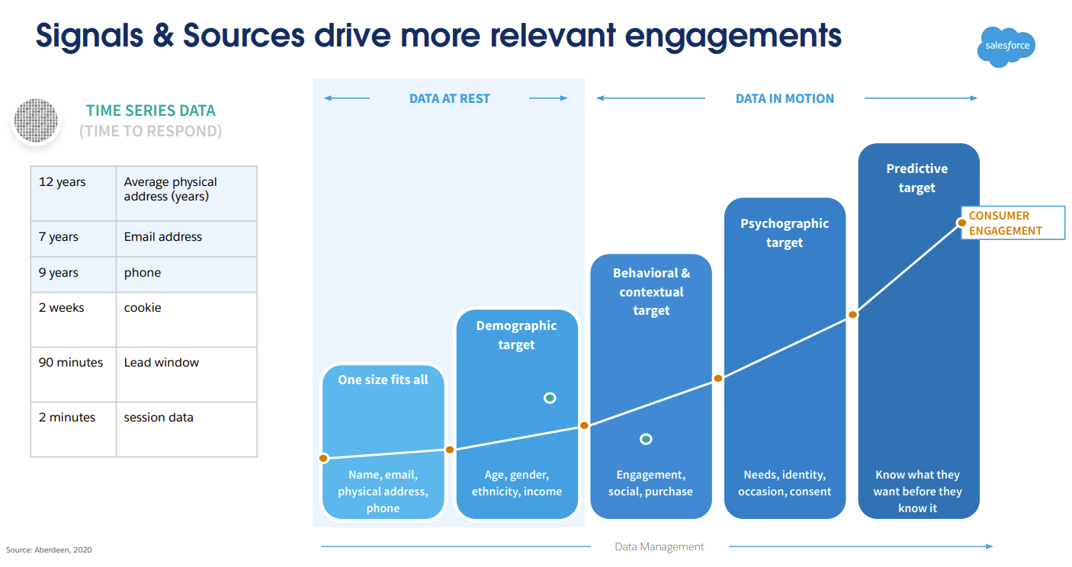
WIP: We need to Speak Their Language

Slide 30
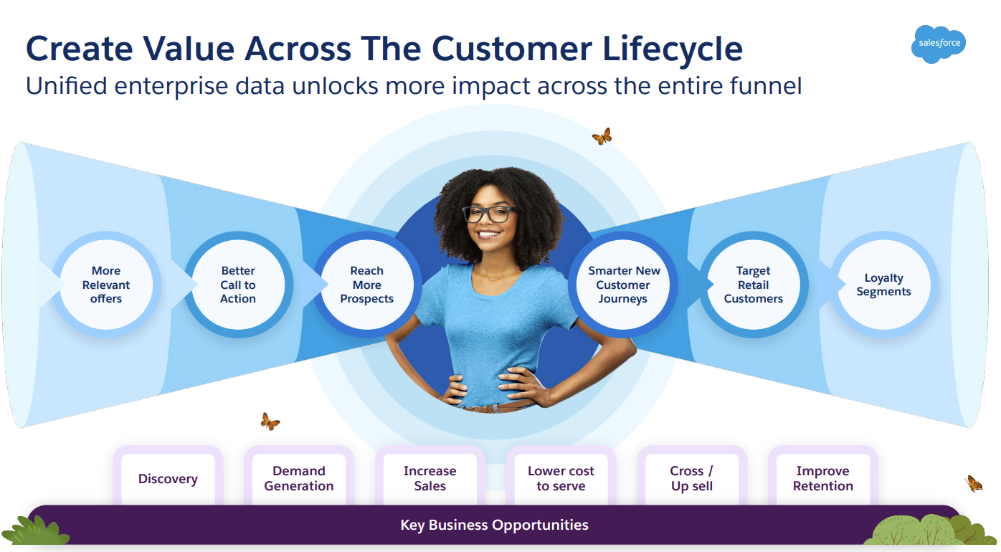
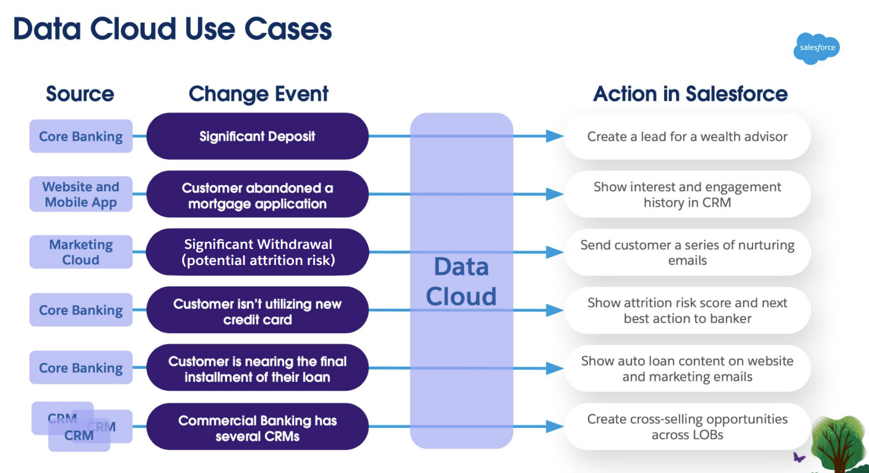
WIP: We need to Speak Their Language

Slide 31
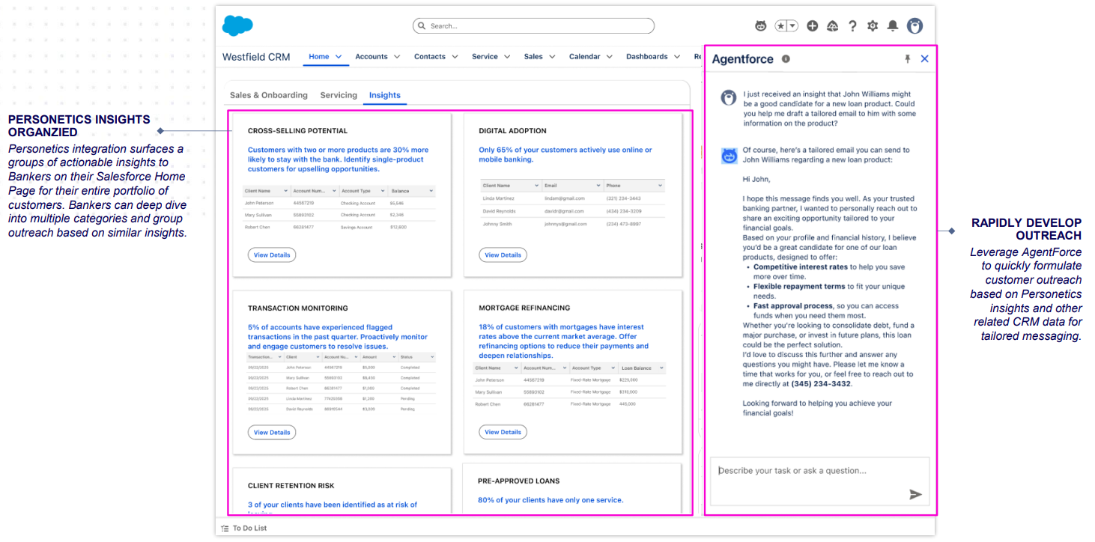
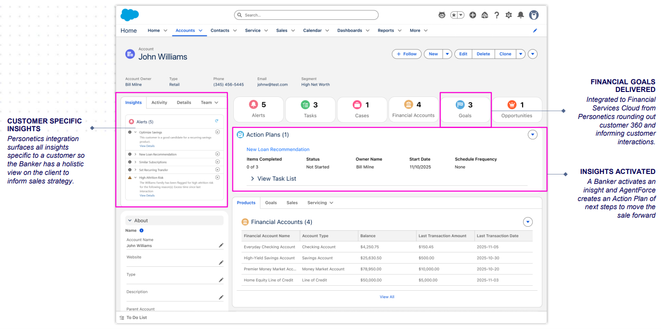
Banker intelligence

Slide 32
Appendix

Slide 33
Personetics for CRM Banker Intelligence - (Sales and Service Clouds)
Use Case: Record and present Personetics personalized insights KPIs directly into Salesforce’s Service Cloud or Sales Cloud dashboards.
Interface - via Lightning App (record highlights, console utility bar)
Trigger - actions via Flow/NBA
Cloud –Sales Cloud, Service Cloud/Financial Services
Packaging –
Managed Package with custom objects (Insight__c) + Lightning Web Components + prebuilt Flows/NBA strategies + Prebuilt reports
Listed in sales and service cloud categories
Pricing - User-based: $X/user/month, aligned with Salesforce licenses
Notes:
What are our guidelines for our transactional data?
What to find out -

Slide 34
Personalized Marketing offers – (Marketing Cloud)
Use Case: Trigger and personalize multi-channel journeys from Personetics insights, and sync audiences for email/SMS/push.
Interface: Journey Builder (entry events & decision splits), Data Extensions, content personalization.
Trigger: insight/threshold met -> Journey Entry Event or Custom Activity; segment updates from Data Cloud -> audience refresh
Cloud: Marketing Cloud
Packaging:
Managed MC Package: Journey Builder Custom Event + Custom Activity, Data Extension schema (Insight_DE),
Pricing: Usage-based: $ per 1k engaged contacts/month (tiered), optional add-on for custom activities.
Notes:
Strategic Alliances for multiple use cases

Slide 35
Agentforce for Financial Services (self service)
Use Case: AI agent answers and acts on transactional requests (balances, transactions, disputes, payments), human agent executes flows (Personetics insights can be used as signals (prioritization/eligibility), not as the agent’s primary knowledge)
Interface: Agentforce workspace panel in Sales/Service console; action bar (Flow/Apex actions).
Trigger: Agent query or transactional event (Case/Opportunity/Balance/Txn change). Optional signal via insights data.
Cloud/Industry: Agentforce + Sales/Service Cloud + Data Cloud
Packaging:
Managed Package: prebuilt Agent skills, Data Cloud grounding, Data Library for policies/FAQs, Copilot Actions bound to named, Flows/Apex guardrails/policies.
Pricing: User-based add-on: $X/agent/month
Later Stage: evaluate making insights available for agents/bots
Notes:
Start with well defined Agent Skills - Balance & Transactions Q&A, Fee Waive , Dispute Start, Payment Plan, Offer Fulfillment),
Data Cloud Grounding - transactions, balances, products, entitlements

Slide 36
Data Cloud integration
Use Case: Unify Personetics attributes into a Profile, compute KPIs, and activate segments back to Core/Marketing Cloud.
Interface – Data Cloud Profile Explorer, Segmentation, Insights, Activation targets (CRM/MC).
Cloud/Industry: Data Cloud (Einstein 1)
Packaging:
Managed Package + DC assets: Data model mapping (Personetics IDs <-> Contact/Account/Household), Ingestion recipe (CRM source + optional direct API), Calculated Insights (e.g., churn risk score, goal progress), segments & activations, sample consent policy.
Pricing: Profile-based: $X per 100k unified profiles/month; optional add-on for direct-to-DC ingestion.

Slide 37
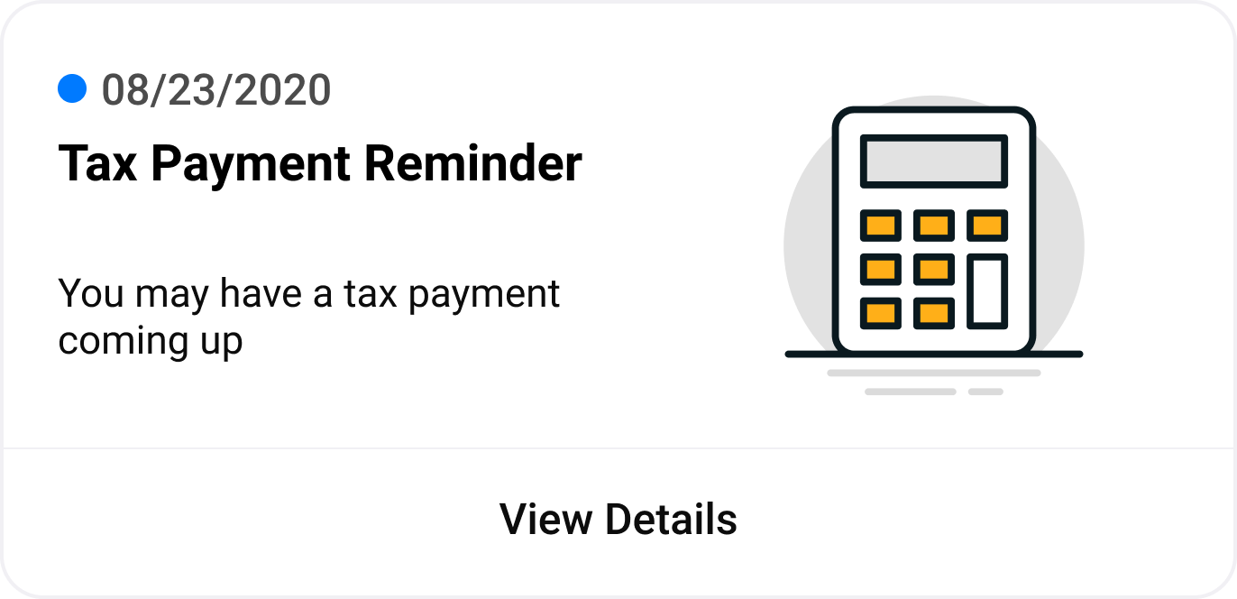
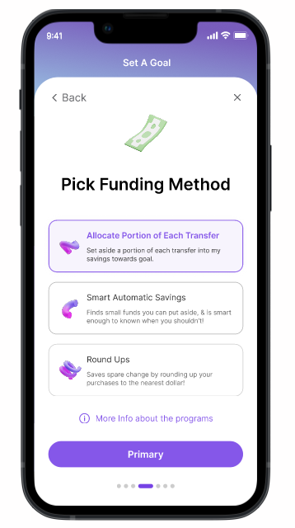
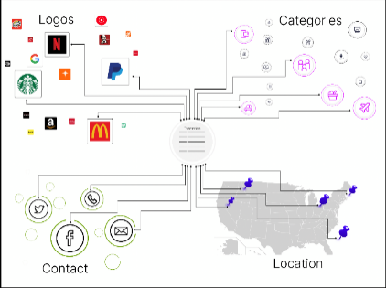
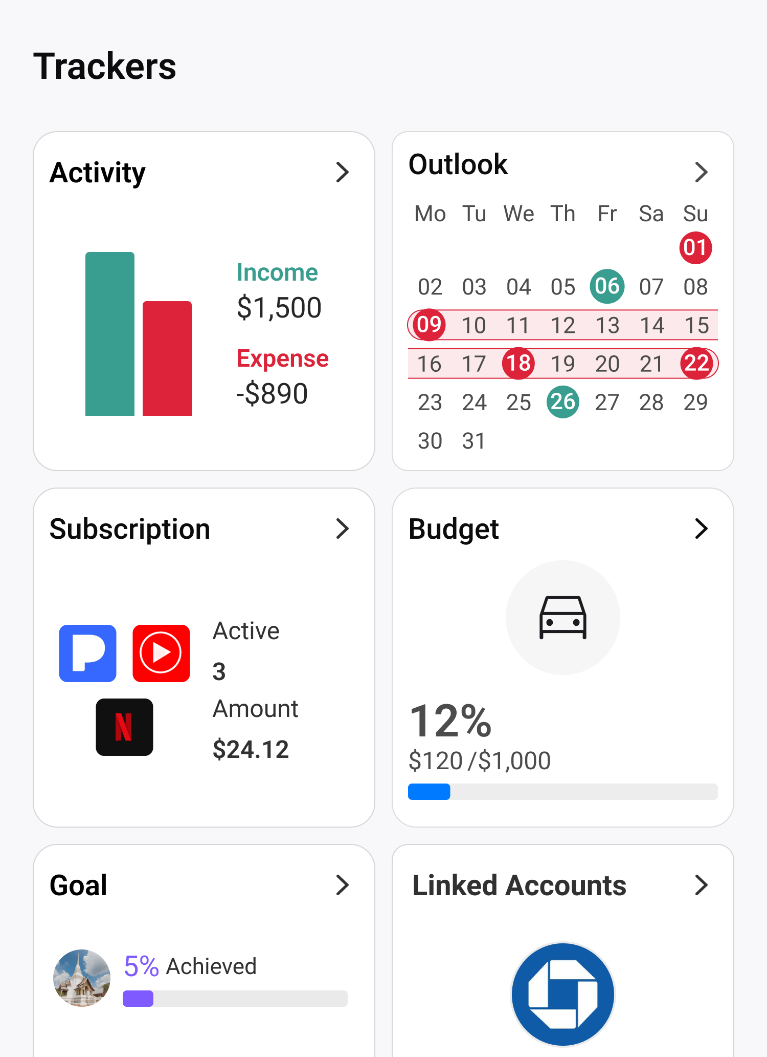
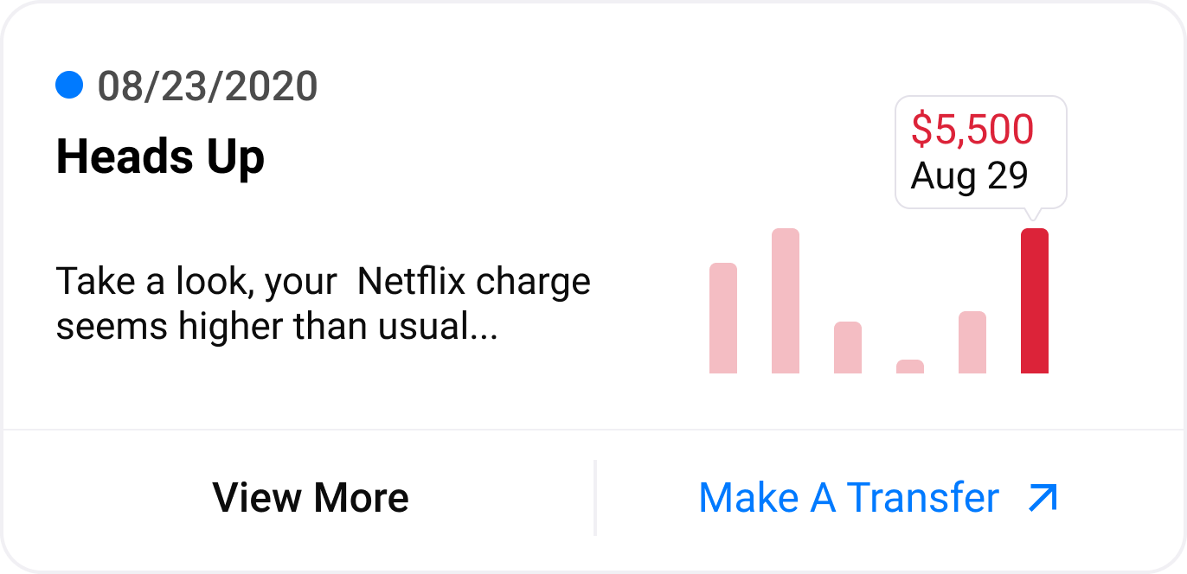
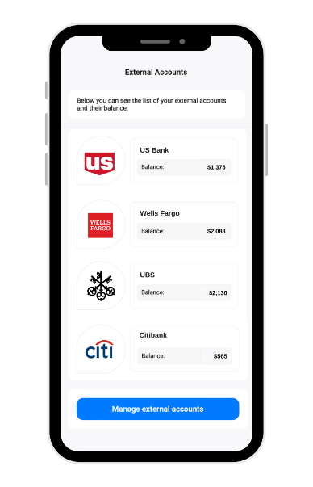


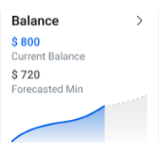


The Personetics platform End-to-end cognitive banking platform
Enrich
Engage
Act
Transaction Enrichment
Money Management
Actionable Insights
Add-Ons
SMB/SME
Auto-saving
SDK & APIs
Admin Customization & Content Management
Analytical Models
- Confidential -

Slide 38
Actionable insights driving value +200 contextual insights with user-level interactivity & pre-designed call-to-actions
ADD-ONS
Smart Budgets
Sustainability
Goal-based Savings
Open Banking
Financial Trackers
Transaction Monitoring
Onboarding & Activation
Bank Services
BASE
Financial Education
Subscription Management
Notifications & reminders
SMB base
Enterprise /Professional
Savings
Credit Cards
Lending
Cashback & Rewards
Notes:
Extensive insight library that spans across multiple business areas, to
(1) encourage financial wellbeing and boost engagement
(2) Drive adoption and cross-sell of bank products and services

